Slide 1
Illusions of Competence, the Importance of Recall, Mini-testing, and Making Mistakes
By Barbara Oakley, PhD

Slide 2
Recall
Illusions of competence
Mini-testing
Value of making mistakes

Slide 3
Recall

Slide 4
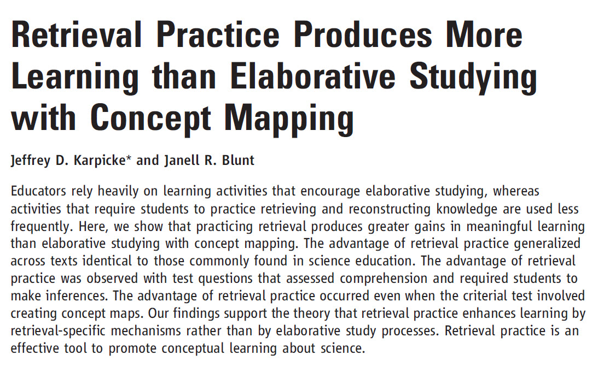
Karpicke, J. D., & Blunt, J. R. (2011). Retrieval practice produces more learning than elaborative studying with concept mapping. Science, 331(6018), 772-775. doi: 10.1126/science.1199327

Slide 5

By simply practicing and recalling, students learned far more and at a much deeper level

Slide 6
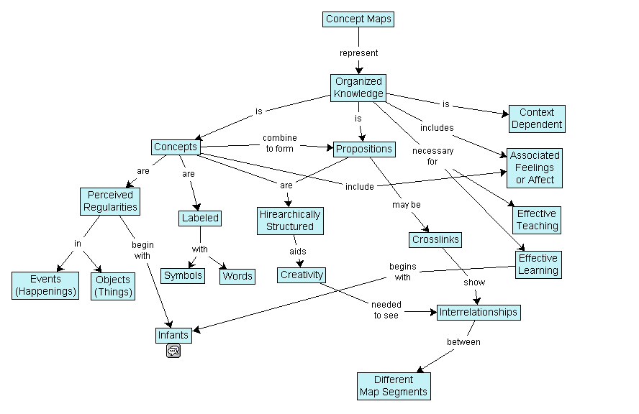

Slide 7

Recall!

Slide 8




Working memory

Slide 9
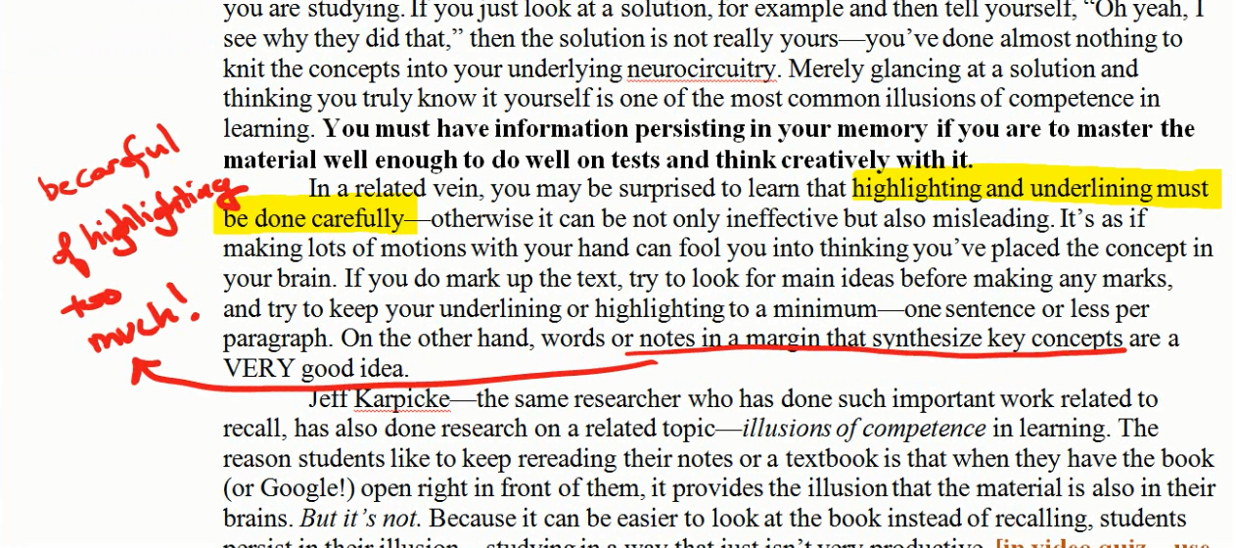

Slide 10
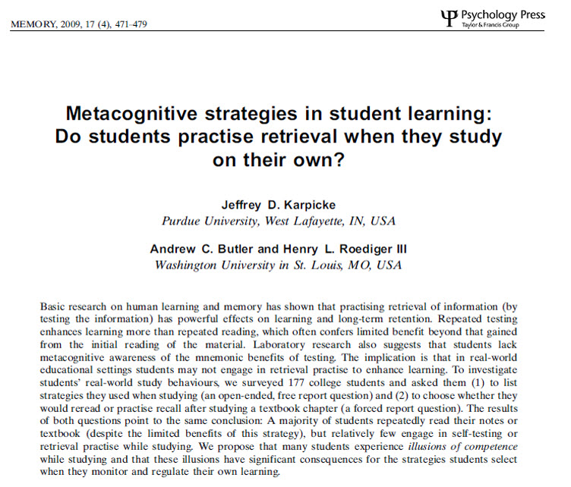

Slide 11


Slide 12
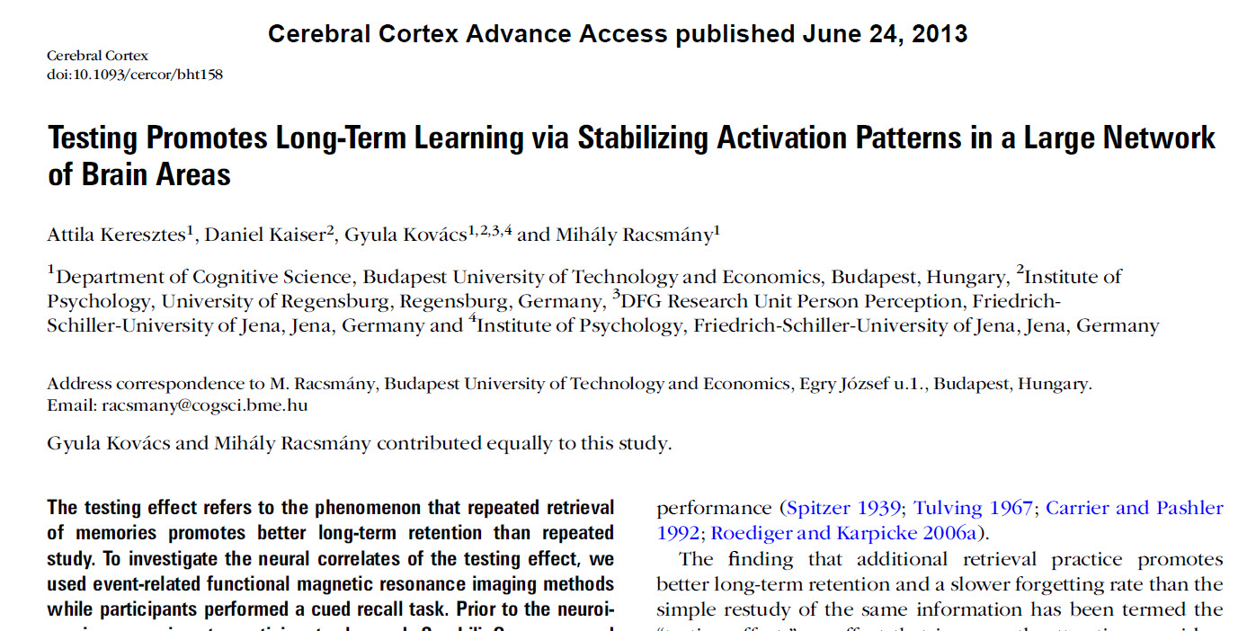

Slide 13





Slide 14
Relevant Readings
Baddeley, A., Eysenck, M. W., & Anderson, M. C. (2009). Memory. NY: Psychology Press.
Brown, J. S., Collins, A., & Duguid, P. (1989). Situated cognition and the culture of learning. Educational Researcher, 18(1), 32-42.
Dunlosky, J., Rawson, K. A., Marsh, E. J., Nathan, M. J., & Willingham, D. T. (2013). Improving students’ learning with effective learning techniques: Promising directions from cognitive and educational psychology. Psychological Science in the Public Interest, 14(1), 4-58.
Dunning, D. (2011). Chapter 5: The Dunning-Kruger Effect: On Being Ignorant of One's Own Ignorance (Vol. 44).
Geary, D. C., Boykin, A. W., Embretson, S., Reyna, V., Siegler, R., Berch, D. B., & Graban, J. (2008). Task Group Reports of the National Mathematics Advisory Panel; Chapter 4: Report of the Task Group on Learning Processes. 2008. Retrieved from http://www2.ed.gov/about/bdscomm/list/mathpanel/report/learning-processes.pdf
Guida, A., Gobet, F., Tardieu, H., & Nicolas, S. (2012). How chunks, long-term working memory and templates offer a cognitive explanation for neuroimaging data on expertise acquisition: A two-stage framework. Brain and Cognition, 79(3), 221-244. doi: 10.1016/j.bandc.2012.01.010
Karpicke, J. D. (2012). Retrieval-based learning active retrieval promotes meaningful learning. Current Directions in Psychological Science, 21(3), 157-163.
Karpicke, J. D., & Blunt, J. R. (2011). Response to comment on 'Retrieval practice produces more learning than elaborative studying with concept mapping'. Science, 334(6055), 453-453.
Karpicke, J. D., & Blunt, J. R. (2011). Retrieval practice produces more learning than elaborative studying with concept mapping. Science, 331(6018), 772-775. doi: 10.1126/science.1199327
Karpicke, J. D., Butler, A. C., & Roediger III, H. L. (2009). Metacognitive strategies in student learning: Do students practice retrieval when they study on their own? Memory, 17(4), 471-479.
Karpicke, J. D., & Grimaldi, P. J. (2012). Retrieval-based learning: A perspective for enhancing meaningful learning. Educational Psychology Review, 24(3), 401-418.

Slide 15
Relevant Readings (cont.)
Keresztes, A., Kaiser, D., Kovacs, G., & Racsmany, M. (2013). Testing promotes long-term learning via stabilizing activation patterns in a large network of brain areas. Cerebral Cortex((Advance access published Jun 24)). doi: 10.1093/cercor/bht158
Kornell, N., Hays, M. J., & Bjork, R. A. (2009). Unsuccessful retrieval attempts enhance subsequent learning. Journal of Experimental Psychology: Learning, Memory, and Cognition, 35(4), 989.
Mastascusa, E. J., Snyder, W. J., & Hoyt, B. S. (2011). Effective Instruction for STEM Disciplines. San Francisco, CA: Jossey Bass.
McDaniel, M. A., & Callender, A. A. (2008). Cognition, memory, and education. In H. L. Roediger (Ed.), Cognitive Psychology of Memory, Vol 2 of Learning and Memory (pp. 819-843). Oxford, UK: Elsevier.
Morris, E. (2010, June 20). The Anosognosic’s Dilemma: Something’s Wrong but You’ll Never Know What It Is (Part 1), The New York Times. Retrieved from http://opinionator.blogs.nytimes.com/2010/06/20/the-anosognosics-dilemma-1/
Pennebaker, J. W., Gosling, S. D., & Ferrell, J. D. (2013). Daily online testing in large classes: Boosting college performance while reducing achievement gaps. PLoS ONE, 8(11), e79774.
Pyc, M. A., & Rawson, K. A. (2010). Why testing improves memory: Mediator effectiveness hypothesis. Science, 330(6002), 335-335.
Roediger, H. L., & Butler, A. C. (2011). The critical role of retrieval practice in long-term retention. Trends in Cognitive Sciences, 15(1), 20-27.
Roediger, H. L., & Karpicke, J. D. (2006). The power of testing memory: Basic research and implications for educational practice. Perspectives on Psychological Science, 1(3), 181-210.
Roediger, H. L., & Pyc, M. A. (2012). Inexpensive techniques to improve education: Applying cognitive psychology to enhance educational practice. Journal of Applied Research in Memory and Cognition, 1(4), 242-248. doi: 10.1016/j.jarmac.2012.09.002
Rohrer, D., & Pashler, H. (2010). Recent research on human learning challenges conventional instructional strategies. Educational Researcher, 39(5), 406-412.

Slide 16
Image Credits
Working memory strands ©Barbara Oakley 2014
Neural hook ©Kevin Mendez 2014
Concept map by Vicwood40 Wikimedia Commons http://en.wikipedia.org/wiki/Concept_map#mediaviewer/File:Conceptmap.gif
Clip art courtesy Microsoft

